Slide 1
What to Bring Camping
BE PREPARED

Slide 2
Resources
Scout Handbook
Merit badge books
Personal Check list
Web based check list
Camping Literature

Slide 3
Why this presentation
Not being prepared can ruin your trip
Not being prepared can ruin the troops trip
Not being prepared can lead to your injury OR DEATH
No being prepared can lead to someone else’s injury or DEATH

Slide 4
Scout essentials
Knife
Matches and fire starters
Compass
Map of area
Water bottle
Flashlight
Pack for gear
Personal first aid kit
Watch
Toothbrush
Tooth paste
Towel
soap
Bag for dirty cloths
Personal role of TP
Hand sanitizer

Slide 5
Troop & Patrol Gear
Troop Gear
Patrol gear
Trailer
Tents & Ground cloths
Tarps and frames and anchoring ropes and stakes
Side curtails
Propane
Hoses
Chernoble
Rope
Dutch ovens
Tables if needed
Pie irons
Ax and saws
Charcoal
Patrol box consumables
Patrol box
Fire wood
Duty rosters
Duty rosters descriptions
Lanterns and mantles

Slide 6
Sleeping
Sleeping bag
  Depending on rating OR style Rectangle vs mummy, may need blanket(s)
  May want to put sleeping bag in a “bag” to protect from the wind
Sleeping mat (closed cell)
Tent, stakes, guy lines
Ground cloth, entry ground cloth
Cloths for sleeping in
  Plastic labeled bag Containing
  Clean sleeping Shirt
  Stocking hat
  Long johns or pajama bottoms
  Clean underwear
  Clean socks (to be used only for sleeping
Bag for your “daily cloths” to maintain order in tent

Slide 7
Environment
Hat
Rain coat
Some type of Rain pant
  Nylon (treated or not)
Water resistant or water proof shoes
Gaitors (can make them)
Warm socks
Warm insulated jacket
Gloves
Long Pants
T-shirt or wicking shirt
Warm long sleeve shirt
Fleece or sweater
Extra socks
Extra pants
Extra Long shirt
Extra underwear
Extra gloves

Slide 8
Meals
Knife
Fork
Spoon
Plate and or bowl
Cup

Slide 9
Advancement
Scout book
Field book
Merit badge books
Other items needed for advancement
  Knife and ax sharpening
  Rope
  Maps
  Compass
  Pencil and paper

Slide 10
Campout Program
Campfire program
  Songs
  Skits
  Stories
  Walk on lines
Advancement theme(s)
  Wilderness survival
  Emergency preparedness
  Geocashing
  ????

Slide 11
What not to bring
Cell phones
Radios
Ipods
Computers
weapons

Slide 12
Summary
Be Prepared for any weather
Use a checklist or some type when packing
Pack in advance, not one hour before

Slide 13
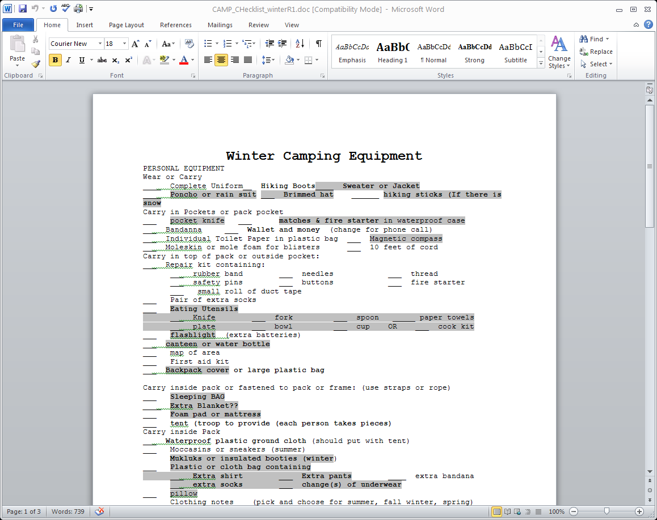

Slide 15
Note kind of trip
Handout is on the folder table

